Slide 1
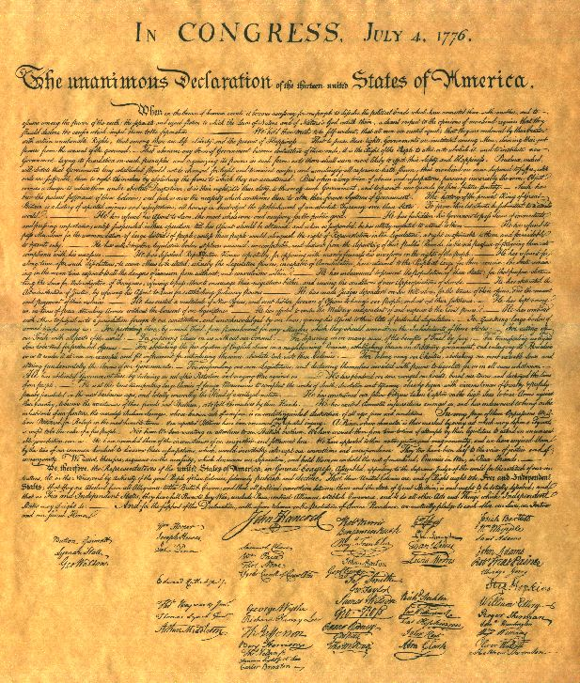
THE DECLARATION OF INDEPENDENCE
Bell Work:
What did you learn about the purpose of writing the Declaration of Independence.
¿Qué aprendió sobre el propósito de escribir la Declaración de Independencia.
Take out your Chromebook, pen or pencil and a piece of paper.
Standard 8.1.2: Analyze the philosophy of government expressed in the Declaration of Independence, with an emphasis on government as a means of securing individual rights (e.g., key phrases such as “all men are created equal, that they are endowed by their Creator with certain unalienable Rights”).
Standard RH 6.6: Identify aspects of a text that reveal an author’s point of view or purpose (e.g., loaded language, inclusion or avoidance of particular facts).
Notes:
1

Slide 2
THE DECLARATION OF INDEPENDENCE
Objective: Identify the author’s purpose in writing the Declaration of Independence and the words that support that purpose.
Notes:
2

Slide 3
THE DECLARATION OF INDEPENDENCE
Relevance:
It’s important for us to understand the purpose of the Declaration of Independence.
The goals and ideals found in the author’s words are the basis of our entire government today.
Notes:
3

Slide 4
Prior Knowledge
Yesterday we learned that after fighting for a year the colonists realized they didn’t know the purpose of the war. When the battles were done, would they end up back under English rule?
What did the colonists choose as their purpose in fighting?

Slide 5
Concept - Identify aspects of the Declaration of Independence that reveal an author’s point of view or purpose (e.g., loaded language, inclusion or avoidance of particular facts).
There is a definite point of view in the Declaration of Independence and it was written with a specific purpose.
We are going to identify the words in the Declaration of Independence that show the author’s purpose.
Skill Steps:
Read the text
Highlight words that describe the author’s purpose.
Explain why those words show the purpose.

Slide 6

Skill - I Do
Steps:
Read the text.
Highlight words that describe the author’s purpose.
Explain why those words show the purpose.
When in the course of human events, it becomes necessary for one people to dissolve the political bands which have connected them with another, and to assume among the powers of the earth, the separate and equal station to which the laws of nature and of nature's God entitle them, a decent respect to the opinions of mankind requires that they should declare the causes which impel them to the separation.
4. Which of the author’s words describe his purpose in writing the Declaration of Independence?
I underlined a decent respect to the opinions of mankind requires that they should declare the causes which impel them to the separation. because it states that they felt the need to tell the world what pushed them to leave England.
Notes:
6

Slide 7
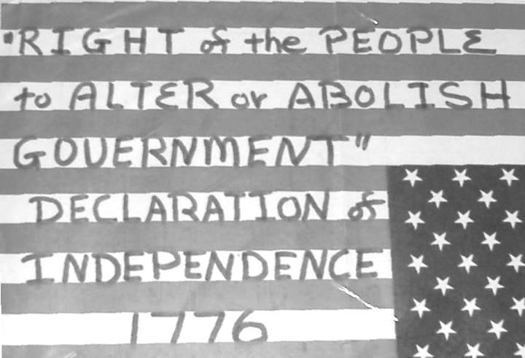
Skill - We Do
Steps:
Read the text.
Highlight words that describe the author’s purpose.
Explain why those words show the purpose.
...that all men are created equal; that they are endowed by their Creator with certain unalienable rights; that among these are life, liberty, and the pursuit of happiness; that, to secure these rights, governments are instituted among men, deriving their just powers from the consent of the governed; that whenever any form of government becomes destructive of these ends, it is the right of the people to alter or to abolish it, and to institute new government, laying its foundation on such principles, and organizing its powers in such form, as to them shall seem most likely to effect their safety and happiness.
5. Which of the author’s words describe his purpose in writing the Declaration of Independence?
I underlined _____________________________________ _ because ______________________________________________
Notes:
the words “whenever any form of government becomes destructive of these ends, it is the right of the people to alter or to abolish it, and to institute new government”
7

Slide 8
Skill - We Do
Steps:
Read the text.
Highlight words that describe the author’s purpose.
Explain why those words show the purpose.
...that all men are created equal; that they are endowed by their Creator with certain unalienable rights; that among these are life, liberty, and the pursuit of happiness; that, to secure these rights, governments are instituted among men, deriving their just powers from the consent of the governed; that whenever any form of government becomes destructive of these ends, it is the right of the people to alter or to abolish it, and to institute new government, laying its foundation on such principles, and organizing its powers in such form, as to them shall seem most likely to effect their safety and happiness.
5. Which of the author’s words describe his purpose in writing the Declaration of Independence?
I underlined __whenever any form of government becomes destructive of these ends, it is the right of the people to alter or to abolish it, and to institute new government_
because _it is say if a government stops protecting our rights we have the right to change or get rid of it and create a new government. __
Notes:
the words “whenever any form of government becomes destructive of these ends, it is the right of the people to alter or to abolish it, and to institute new government”
8

Slide 9

Skill - Independent Practice
Steps:
Read the text.
Highlight words that describe the author’s purpose.
Explain why those words show the purpose.
But when a long train of abuses and usurpations, pursuing invariably the same object, evinces a design to reduce them under absolute despotism, it is their right, it is their duty, to throw off such government, and to provide new guards for their future security. Such has been the patient sufferance of these colonies; and such is now the necessity which constrains them to alter their former systems of government. The history of the present King of Great Britain is a history of repeated injuries and usurpations, all having in direct object the establishment of an absolute tyranny over these states. To prove this, let facts be submitted to a candid world.
6. Which of the author’s words describe his purpose in writing the Declaration of Independence?
I underlined ____________________________________________ because ________________________________________________
Notes:
To prove this, let facts be submitted to a candid world
9

Slide 10
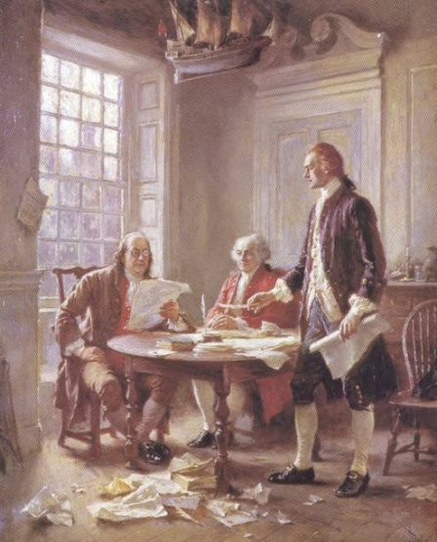
Closure
Write a response (at least one paragraph) to the following prompt:
What was the author’s purpose in writing the Declaration of Independence and what are some of the words in the Declaration that demonstrate this was the author’s purpose?
You will be expected to:
Introduce a topic statement clearly and effectively, previewing what is to follow
Respond to both questions
Cite evidence from the Declaration of Independence.
Notes:
7. To justify to the world that the colonists had good reasons for abolishing English government in America.
8. they should declare the causes which impel them to the separation; it is the right of the people to alter or to abolish it; let facts be submitted to a candid world
10

